Slide 1
Customer Churn Prediction
November 23, 2021

Slide 2
Problem Statement
Music streaming company KKBOX wants to predict whether a user will churn after their subscription expires
Understanding the drivers of customer churn will help the company employ tactics to reduce churn
My goal is to use the data provided by the company to build a model that accurately predicts customer churn

Slide 3
Input Datasets
KKBOX provided several datasets at different levels of aggregation:
Dataset
Train data
Transactions data
User logs data
Member data
Description
User level, indicates whether customer churned
List of transactions for each user, includes subscription upgrade and cancellations
Daily user activity on the streaming platform, includes number of songs played daily
Member info, includes registration type, city, age, gender
Sample Fields
User id, churn indicator
user id, payment_plan_days, plan_list_price, actual_amount_paid, is_auto_renew, transaction_date, is_cancel
user id, number of unique songs played, total seconds played, number of songs with <25% of the song length played
user id, city, age, registration type, expiration date

Slide 4
Data Processing & EDA
Several stages of processing and EDA were completed
Stage
Initial Data Summarization
Data Merging
Combined Features EDA
Description
Aggregate all datasets at the user level in order to capture a wholistic training dataset
I.e.: Daily User logs dataset was summarized to understand how users interacted with the service as a whole
Some initial, simple, EDA was conducted after aggregation
Merge all aggregated datasets by user id, in order to create a master training dataset
Combined dataset contains features such as:
Average payment plan price
Auto renew rate
Total number of unique songs played
Using master training dataset, conduct additional EDA
Combined features together to help identify “pure classes”
Filtered out pure classes in order to drill down further into remaining customer data
Considerations
What are the right aggregate metrics?
Total counts, averages, medians, etc.?
How will these aggregations affect downstream EDA?
N/A
Since the dataset is very large (15 GB+), how can I conduct faster EDA?
What are the different combinations of features that I can use to help identify trends and pure classes?

Slide 5
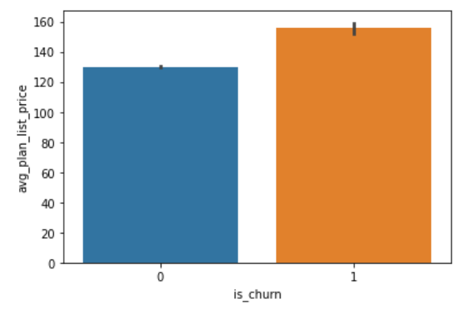
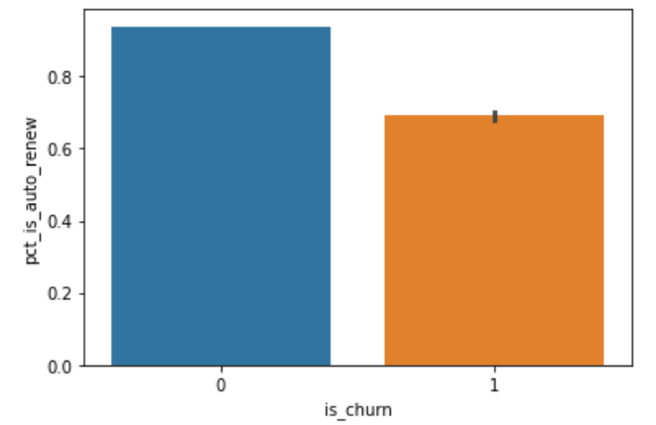
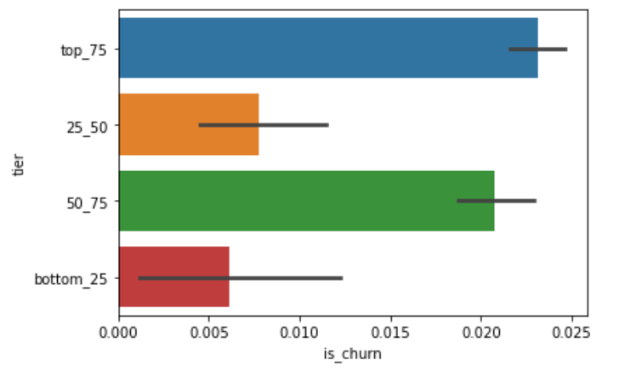
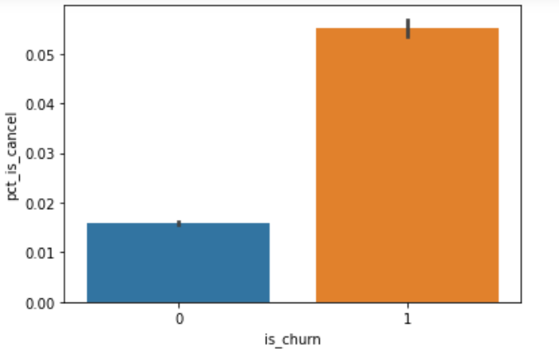
Features
Several derived features were found after EDA, including plan list price, auto renew rate, number of songs played (tiered by quartiles), and cancel rate:
Higher average plan list price per user is correlated with higher churn
Higher auto-renew rate is correlated with lower churn
Interestingly, users who listened to more unique songs than the median user had a much higher churn rate
Customers who cancel their service often (whether or not to upgrade) churned more often

Slide 6
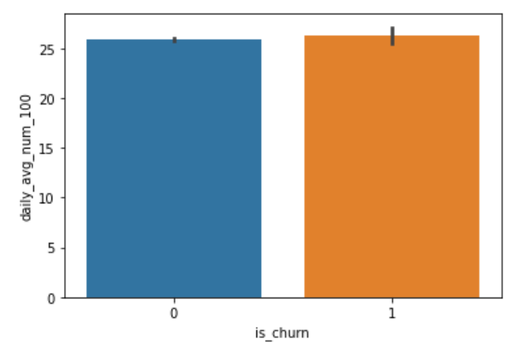
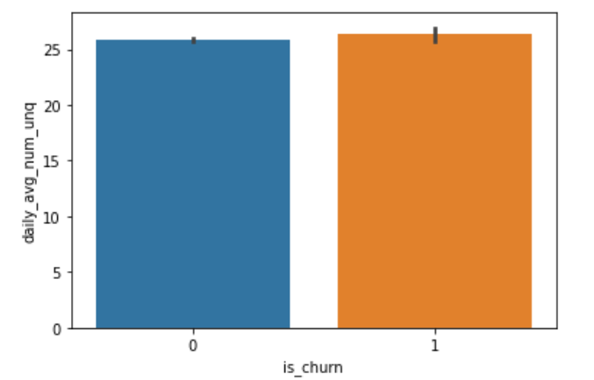
Non-impactful Features
There were several features that interestingly did not seem to affect churn:
There was no meaningful difference between churned users and active users for number of songs played to 100% completion
The initial view into churn by average number of unique songs played showed that there was no meaningful difference – however further drilldown after identifying pure class by cancel rate did help show some differences

Slide 7
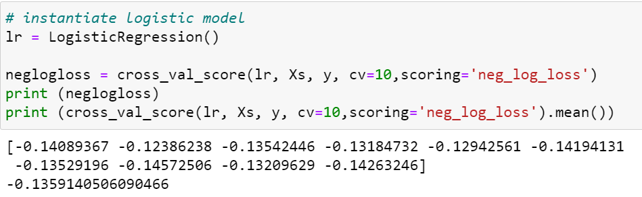
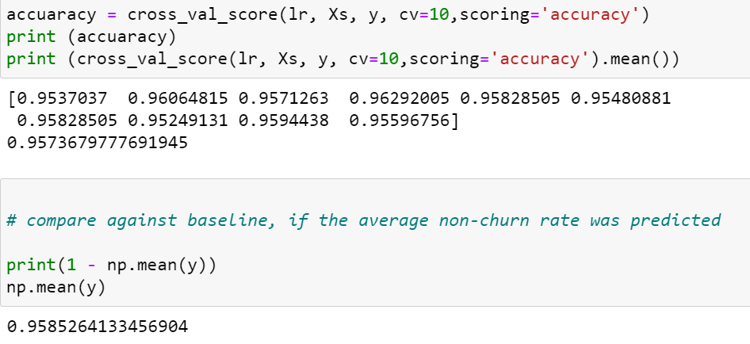
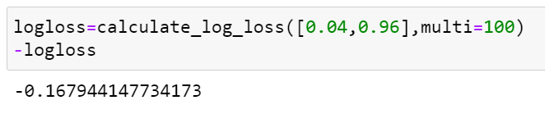
Model Evaluation
Logistic regression and cross validation was used to predict churn, and the scoring metrics selected were log loss (Kaggle) and accuracy
Log loss can be a better evaluation metric than accuracy because log loss penalizes false classifications, like MSE
Scoring: Negative Log Loss
Scoring: Accuracy
Model
Model
Baseline
Baseline
The closer to 0 the better – the model was better than the baseline (churn = 0) at predicting churn, after accounting for false classification penalization
The accuracy of the model was in line with the baseline, although this isn’t as meaningful because 96% of users did not churn

Slide 8
Feature Importance
The derived features used in the model, and the listed feature importance:
'avg_plan_list_price’ Score: 0.03641
'pct_is_auto_renew’ Score: -0.86161
'pct_is_cancel’ Score: 0.40111
‘low_cancel_low_usage_users’ Score: -0.82437

Slide 9
Next Steps
Process Optimization:
Sample the data from the onset – since the datasets were extremely large, EDA was heavily disrupted due to long wait times
At times, computer ran out of memory when running simple group bys and bar charts
Additional EDA:
The datasets provided are rich with information, only the surface was scratched
Additional features to look into:
Payment plan type
Demographic data (age, city) and registration type
Model optimization
Feature selection through random forest classification
Predict using another classifier such as KNN

